Slide 1

Tree.st
If Google organizes the pages of the web,
Tree.st organizes the people in communities

Slide 2





Tree.st / Macro vs. Micro Qualities
Macro
BAR State
Disease
Gender
Education
Insurance
Age
Practice
Medicine
Location
Micro
Lawyer
Patient
Consumer
Personality
Economic
Left-handed
Judges
Family?
Borrow?
Cases
Side-effects
Loves…
Work Style
Prevalence
Traveled to
Tree.st
…
…

Slide 3
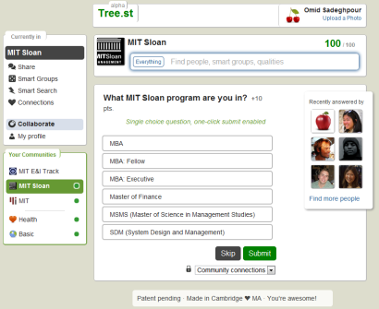
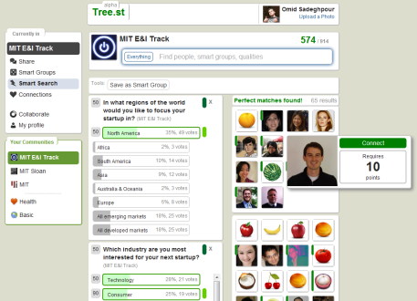
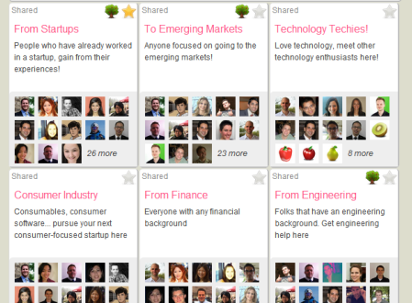
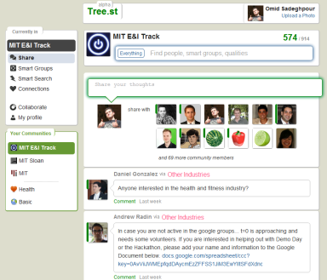
Tree.st / How we do it
GATHER
SEARCH
GROUPING
CONNECTING
Via a decision tree of questions we quickly gather the unique attributes for each user in a community
Enable users to search for others based on the same unique attributes of the community
With our patent-pending “smart groups” we automatically place users in groups based on their unique qualities
Tree.st enables community members to connect and broadcast messages in small focused groups
(Appendix A)
(Appendix B)
(Appendix C)
(Appendix D)
SAFE & SECURE
In a platform that ensures data safety, anonymity when needed, de-centralization, security and redundancy
INTELLECTUAL PROPERTY
Submitted a provisional patent application 07/02/2012, with two independent landscape studies by 10/30/2012

Slide 4
Tree.st / Validation
MIT SLOAN
Characterized 40% of MIT Sloan (400+ Students)
40%
in 2 weeks
Gathered 45 unique attributes never before stored in one platform, without any funding
Automatically categorized students in 20+ “smart groups”
Students began communicating by email about recruiting, going out, gluten-free ideas, startups, etc.
ENTREPRENEURSHIP & INNOVATION TRACK
Before classes began, Tree.st had already automatically
grouped all the students using 58 unique attributes
58
attributes
By the first E&I class ,80% of the students were on the E&I Tree.st community
Entrepreneurs quickly began communicating and brainstorming
UPCOMING COMMUNITIES
VMS Mentors (i.e.: you), 20Under20, MIT Energy Club, Mobile Monday
1200+ members

Slide 5
Tree.st / Market
MARKET SIZE
Over 2,000,000 organizations with no organizational solution to connect their human capital
VERTICALS
Patient communities, associations, 3rd party solution vendor for conferences & tradeshows, universities and high schools. Primarily businesses and enterprises
Diverse Community
Talent Management & Searching
Communica-tion Channels
Defined but Fluid Leadership
Common Challenges
Shared Experiences
Collaboration/ Teamwork
We aim to deploy Tree.st from the bottom-up within organizations (i.e. Yammer or Facebook) – but focus our community qualities on use cases that improve the collaborative focus of such communities
We intend to begin with the highest margin, fastest sales cycle verticals, and move to larger impact verticals later
Community
Areas of Focus
COMPETITIVE LANDSCAPE
Ark.com / Single-vertical solutions / SharePoint / SAP

Slide 6
Tree.st / Looking for…
Description
Date
Demos
Demo our product to all of you, directors, and managers within your organization or associations
October
Mentors
Mentors familiar with online social space, enterprise space, or familiar with the different market verticals we will approach
October
Clients
Two or three more clients
November
Funding
Funding: $2M
May 2013

Slide 7
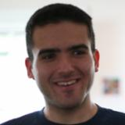

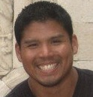
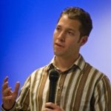
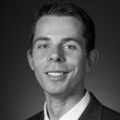
Tree.st / Team
Omid Sadeghpour (Co-founder)
BS Engineering UC Berkeley. LLNL & DOE Big Data Software Developer. Startups: Applied Proteomics Inc. (Series B: $22.5M), Dailysite.com. MIT Sloan MBA ‘13
Tung Shin Wong
Lead User Experience Designer at Method
6 yrs. Consumer Experience Design Mobile and Internet. Ravensbourne College of Design and Communication BA (Hons), Interaction Design
Alex Sanchez (Co-founder)
Former Head of Product Innovation, Orange / France Telecom. 10+ yrs. Consumer Mobile, Internet Services, Product design, Product Mgmt. MIT Sloan MBA ‘13
Yu Xin
PhD Student – Data Analytics
Machine Learning Group Computer Science and Artificial Intelligence (CSAIL) Lab, MIT
Adam Borelli
Managing Director of MIT $100K. B.A. UC Berkeley. Google. Startups: New Leaders Council. Extensive community building experience. MIT Sloan MBA ‘13
Akash Badshah
Software Developer – Web and Mobile
BS Computational Biology and Physics ‘13, MIT
Alexander Romanov
BS Engineering Colorado. Communication satellites testing, Supplier management, and Rock Band management. MIT Sloan MBA ‘13
Victor D. Pontis
Software Developer – Web and Mobile
BS Computational Biology and Physics ‘13, MIT

Slide 8

Tree.st / Appendix A – Gathering

Slide 9

Tree.st / Appendix B - Searching

Slide 10

Tree.st / Appendix C – Smart Groups

Slide 11

Tree.st / Appendix D - Sharing

Slide 12
Tree.st / Appendix E - Financials
With three product tiers (Enterprise in-location, SaaS, and open-source) we will breakeven in 14 quarters (3.5 years)
Given our predictions our firm, in the early stages will have financials similar to LinkedIn and Microsoft
Given that we monetize without advertisements, we aim to have higher revenues, around $10-20 per member-year, as opposed to $6 per advertised member-year

